Slide 1
Generalized Linear Mixed-Effects Models (GLMMs) for Investigating Trends in Long-term Benthic dataset
OBBN Semi-Annual Biomonitoring Meeting
January 17, 2017
By Patrick Schaefer
Notes:
Add title, who the presentation is to, who it is by and the date.

Slide 2
Part 1. What are Generalized Linear Mixed Models
Part 2. Use of Generalized Linear Mixed Models for determining trends in benthic macroinvertebrates communities in the Credit River Watershed

Slide 3
Part 1- GLMMs
“All Models are wrong, but some are useful” – George Box
“But which ones?” – the crowd
What is the purpose of a model? Understand the effects of predictors (independent variables) X on a response (dependent variable) Y
A scientific model is an abstraction of reality, the parts of reality we can measure and understand

Slide 4
Part 1- GLMMs
Generalized Linear Mixed Effects Models (GLMM)
A generalization of ANOVA/Regression framework that allows for fixed and random effect as well as non-normal response distributions
Model Hierarchy:
Generalized Linear Mixed Effects Model
Linear Mixed Effects Model
Linear Model
Regression
ANOVA

Slide 5
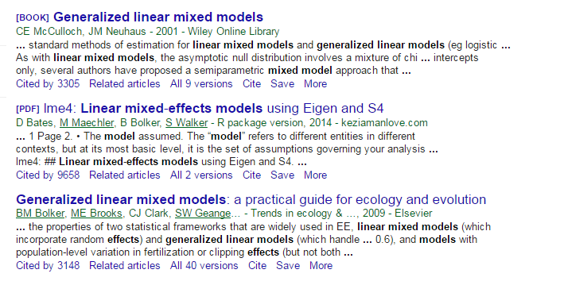
Part 1- GLMMs
Have become common, especially in Ecology post-2000, with increased access to powerful computer software and development of new algorithms

Slide 6
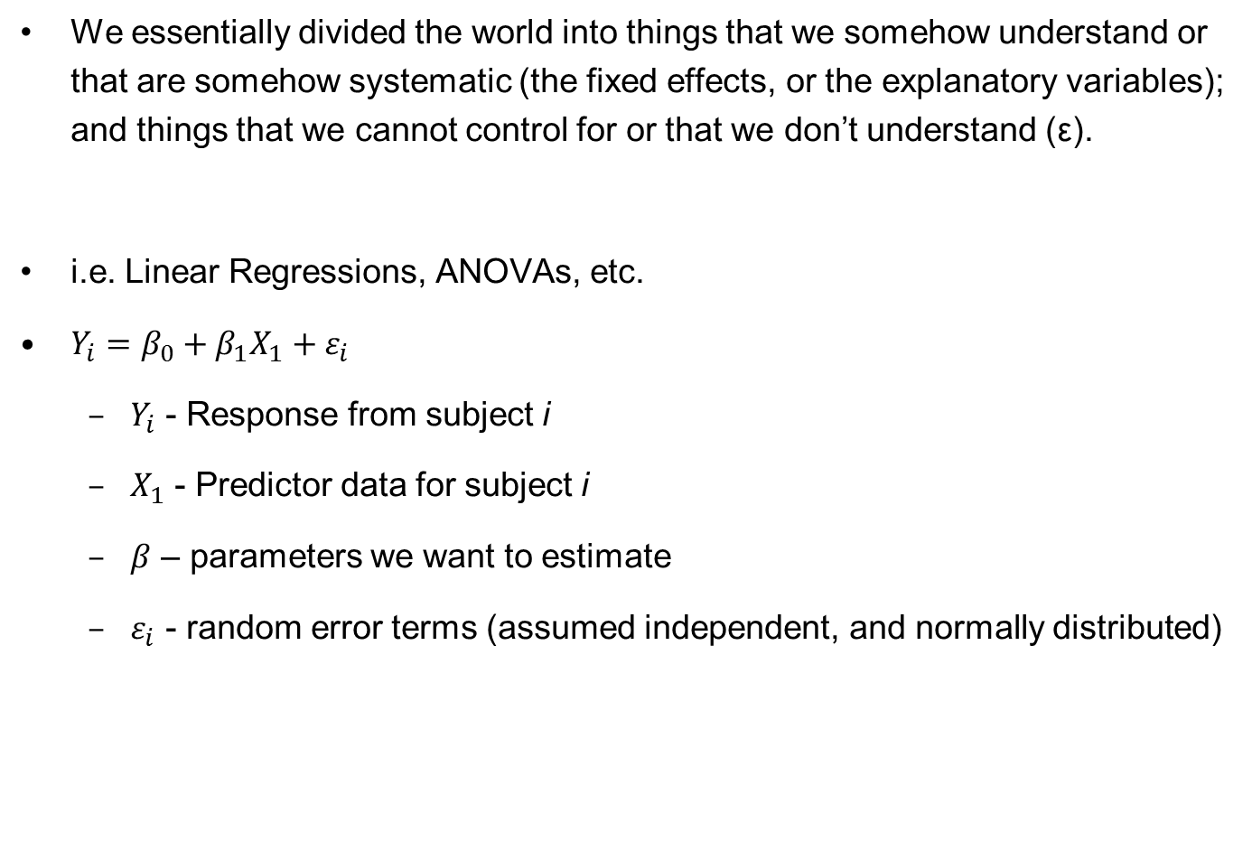
Fixed Effects Models
We essentially divided the world into things that we somehow understand or that are somehow systematic (the fixed effects, or the explanatory variables); and things that we cannot control for or that we don’t understand (ε).
i.e. Linear Regressions, ANOVAs, etc.
$Y_{i}=β_{0}+β_{1}X_{1}+ε_{i}$
$Y_{i}$ - Response from subject i
$X_{1}$ - Predictor data for subject i
$β$ – parameters we want to estimate
$ε_{i}$ - random error terms (assumed independent, and normally distributed)

Slide 7
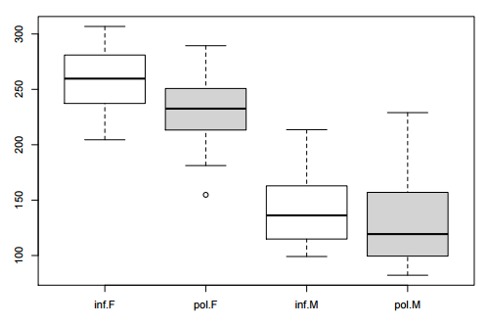
Fixed Effects Models
From a commonly used example dataset: Pitch of speech was measured in an experiment under 2 treatment factors (informal vs. polite) across 19 subjects and 7 scenarios (items).
pitch ~ politeness + sex + ε
Winter, B. (2013). Linear models and linear mixed effects models in R with linguistic applications.

Slide 8
Fixed Effects Models
Technically: the standard linear model insists that error (and hence) observations are independent; if not, the model is not valid
conceptually:
the accuracy of the estimates (and our confidence in them) is captured in the standard errors of the regression coefficients;
the linear model assumes there are N independent pieces of information when it computes these standard errors;
if observations are correlated, however, there really aren’t N independent pieces of information, and the estimated standard errors will be too small

Slide 9
Fixed Effects Models
Types of non-independent data
Hierarchical data
Clustered data
Matched data
Longitudinal data
Repeated Measures

Slide 10
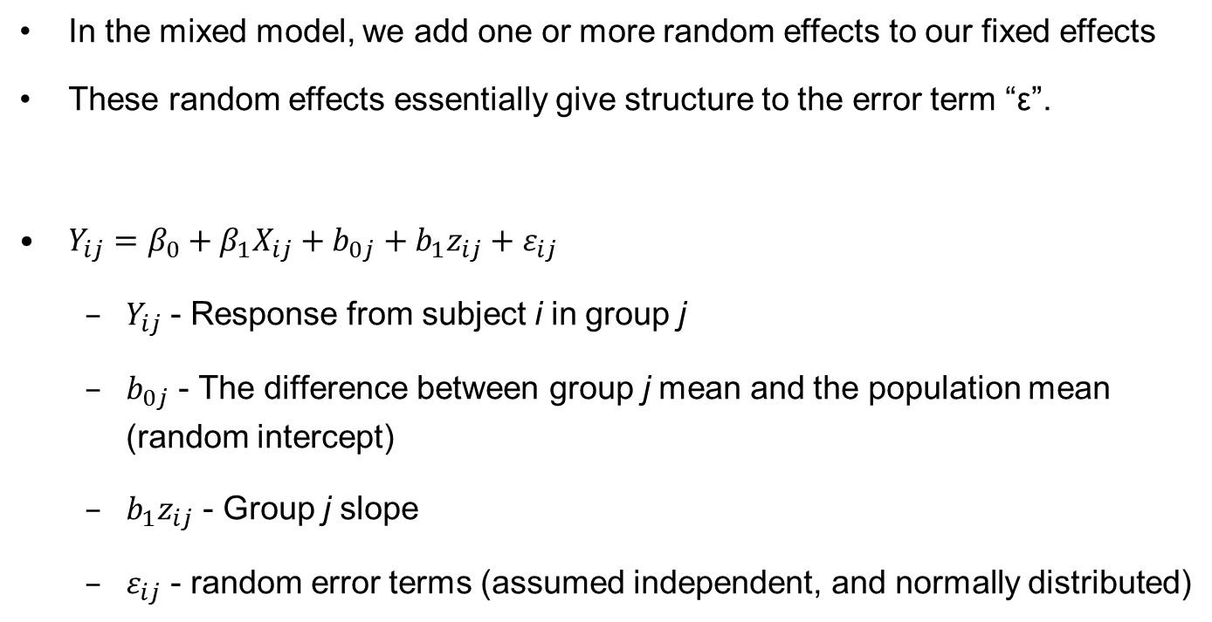
Mixed-Effects Models
In the mixed model, we add one or more random effects to our fixed effects
These random effects essentially give structure to the error term “ε”.
$Y_{ij}=β_{0}+β_{1}X_{ij}+b_{0j}+b_{1}z_{ij}+ε_{ij}$
$Y_{ij}$ - Response from subject i in group j
$b_{0j}$ - The difference between group j mean and the population mean (random intercept)
$b_{1}z_{ij}$ - Group j slope
$ε_{ij}$ - random error terms (assumed independent, and normally distributed)

Slide 11
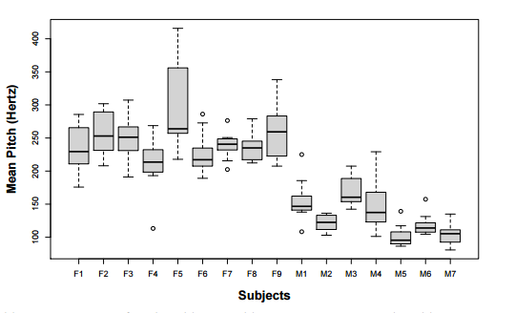
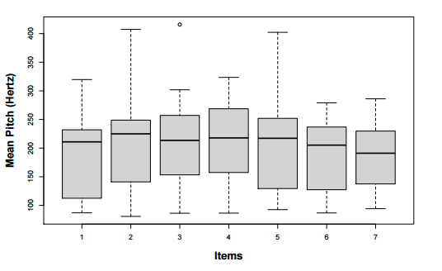
Mixed Effects Models
In the case of the speech dataset, we add a random effect for “subject”, and ‘Item” and this characterizes idiosyncratic variation that is due to individual differences
pitch ~ politeness + sex + (1|subject) + (1|item) + ε
This has “resolved” the non-independencies (our model knows that there are multiple responses per subject and per item), and we accounted for by-subject and by-item variation in overall pitch levels

Slide 12
Random Effects
Traditionally: a way of correcting statistical tests when some observations are correlated
Sometimes considered nuisance variables, parameters not of interest to the experimenter (e.g. replication group, year, etc.)
Modern: Combine information from different levels within a grouping variable.
A predictor variable where you are interested in making inferences about the distribution of values, rather than testing differences of values between particular levels.
Trading the ability to test hypothesis about particular levels for ability to (1) quantify variance among levels and (2) generalize to unmeasured levels.

Slide 13
Generalizing the LMM
In a linear model, Y itself can be expressed as a linear combination of covariates X (plus ε). That formulation requires that Y be able to take on any real value, and that’s obviously not the case for all data.
GLMMs allow us to apply linear modeling approaches in situations where responses are not distributed over the entire set of real numbers. This extension is done by transforming the responses via a link function, which is matched to a reasonable probability density function for the response data in hand.
Probability density functions commonly used in ecology are binomial, Poisson, negative binomial, and gamma functions, although the structure extends to many other density functions as well.

Slide 14
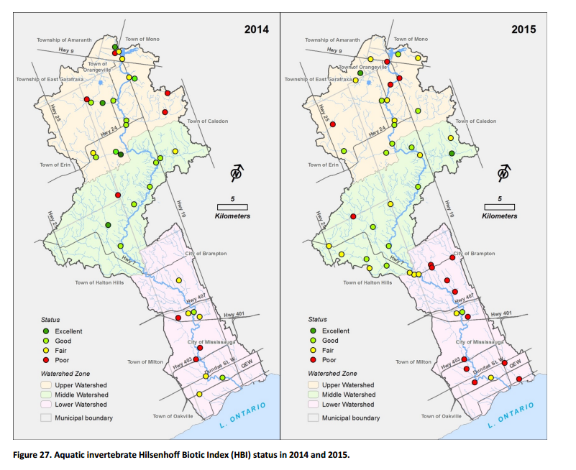
Introduction
Credit Valley Conservation has been collecting environmental data since 1999 through its Integrated Watershed Monitoring Program (IWMP)
What is the ecological health of the Credit River watershed?
Goal: Identify status and trends in the integrity of biotic communities at the watershed, zone and site scales
Notes:
Add general content.

Slide 15
Introduction
Sampling effort has been variable – 25-50 sites sampled annually between 1999-present
Many sites were sampled repeatedly for several years
However, sampling, processing and level of taxonomic resolution have all been inconsistent across the IWMP sampling period

Slide 16
Methods
Questions:
Which aspects of the biotic community are we interested in monitoring?
Are there significant trends in those aspects of the biotic communities at the watershed, zone and site scales?

Slide 17
Methods
Questions:
Which aspects of the biotic community are we interested in monitoring?
Shannon’s diversity Index = overall measure of biodiversity, combines richness and dominance
Percent modified EPT = EPT without Baetidae and Hydropsychidae
Percent Isopoda + Chironomidae + Hydropsychidae + Amphipoda + Elmidae + Baetidae + Oligochaeta (ICHAEBO) = taxa that increase in dominance with a variety of disturbances
Hilsenhoff Biotic Index (HBI) = Community sensitivity to organic pollution
Scrapers + Grazers : Shredders + Collectors = Autotrophic vs. Heterotrophic energy sources
Burrowers : Sprawlers + Clingers = Benthic vs. hyporheic habitat use
Canadian Ecological Flow Index (CEFI) = preferred current velocity of benthic community

Slide 18
Methods
Questions:
2. Are there significant trends in those aspects of the biotic communities at the watershed, zone and site scales?
50 individual linear regressions (1 per site) + 3 zones + 1 watershed * 7 metrics
NOPE NOPE NOPE NOPE NOPE!
Multiple regression – sites and time as predictor variables
Maybe, but sampling events are not independent of each other in space or time
Repeated Measures ANOVA/ANCOVA
Unequal sampling would mean a lot of averaging meaning lost data and non-normal response variables would make inferences questionable

Slide 19
Methods
2 models built for each metric
Site trend model:
metric ~ Sampling_Method + (Year | Site) + (1 | Year)
If 95% Confidence Intervals of the slope parameter “year” do not overlap 0, we consider the trend significant
Watershed and Zone trend model:
metric ~ Sampling_Method + Zone*Year + (Year | Site) + (1 | Year)

Slide 20
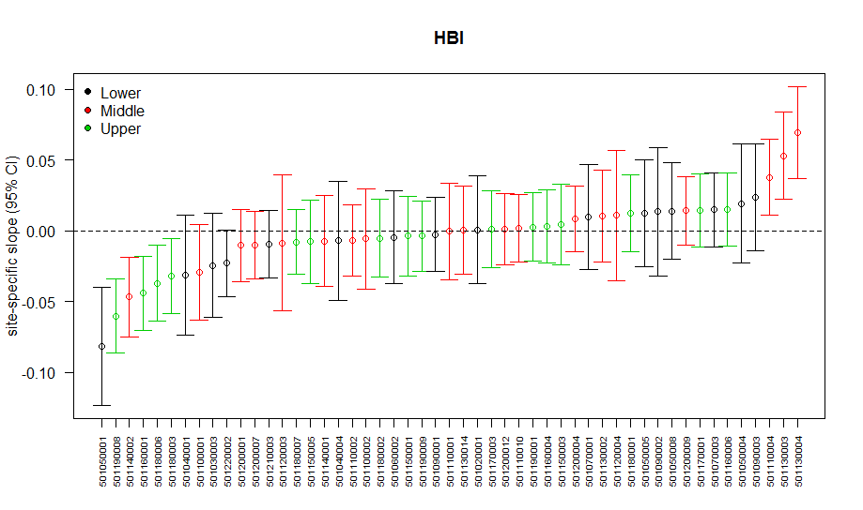
Results 1 - Site trend model

Slide 21
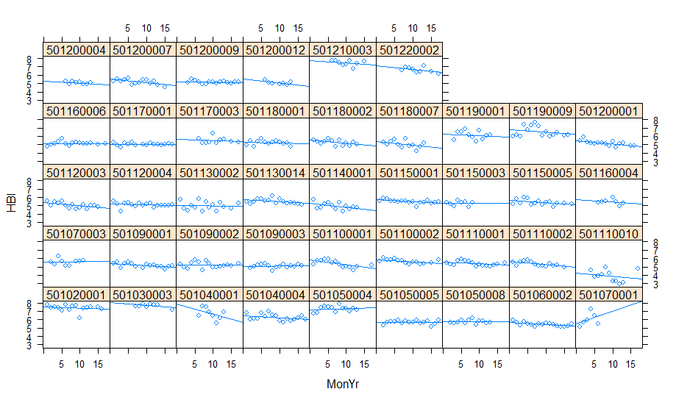
Results 1 - Site trend model
Sites not displaying a trend

Slide 22
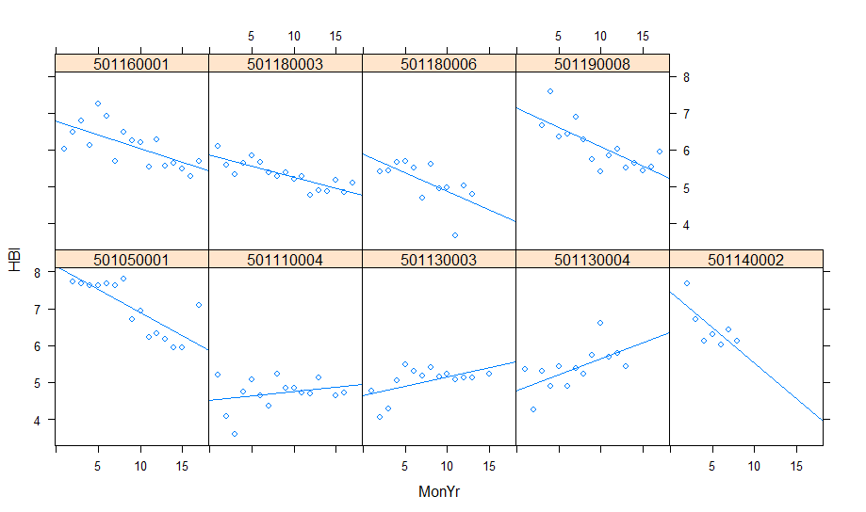
Results 1 - Site trend model
Sites displaying a significant trend

Slide 23
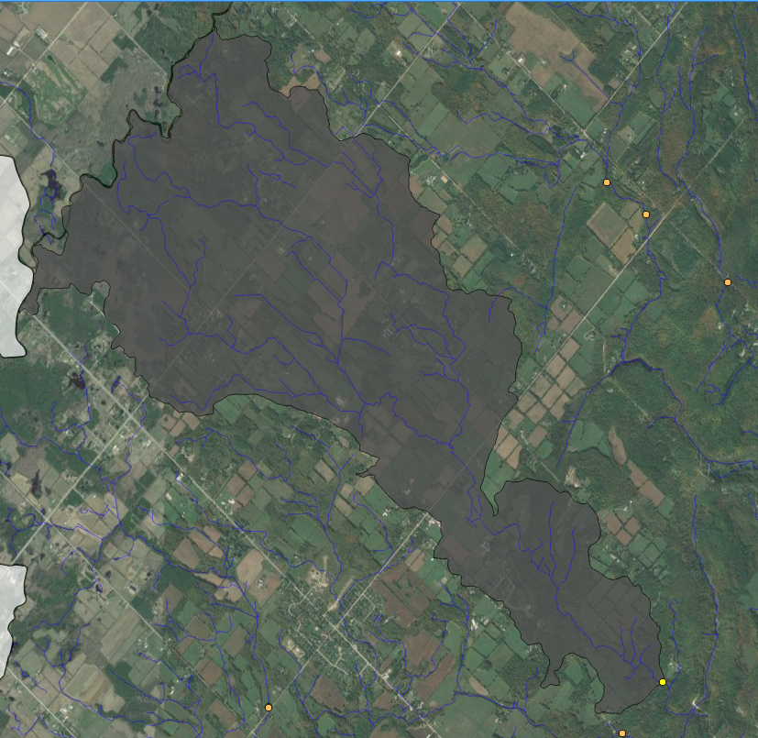
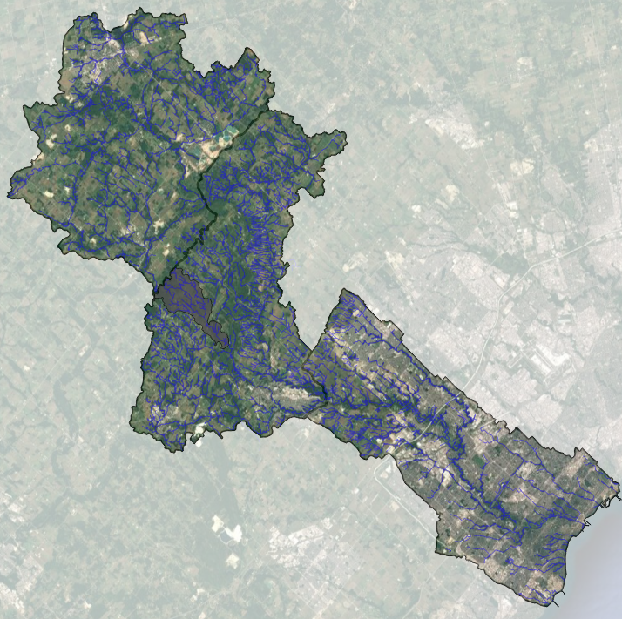
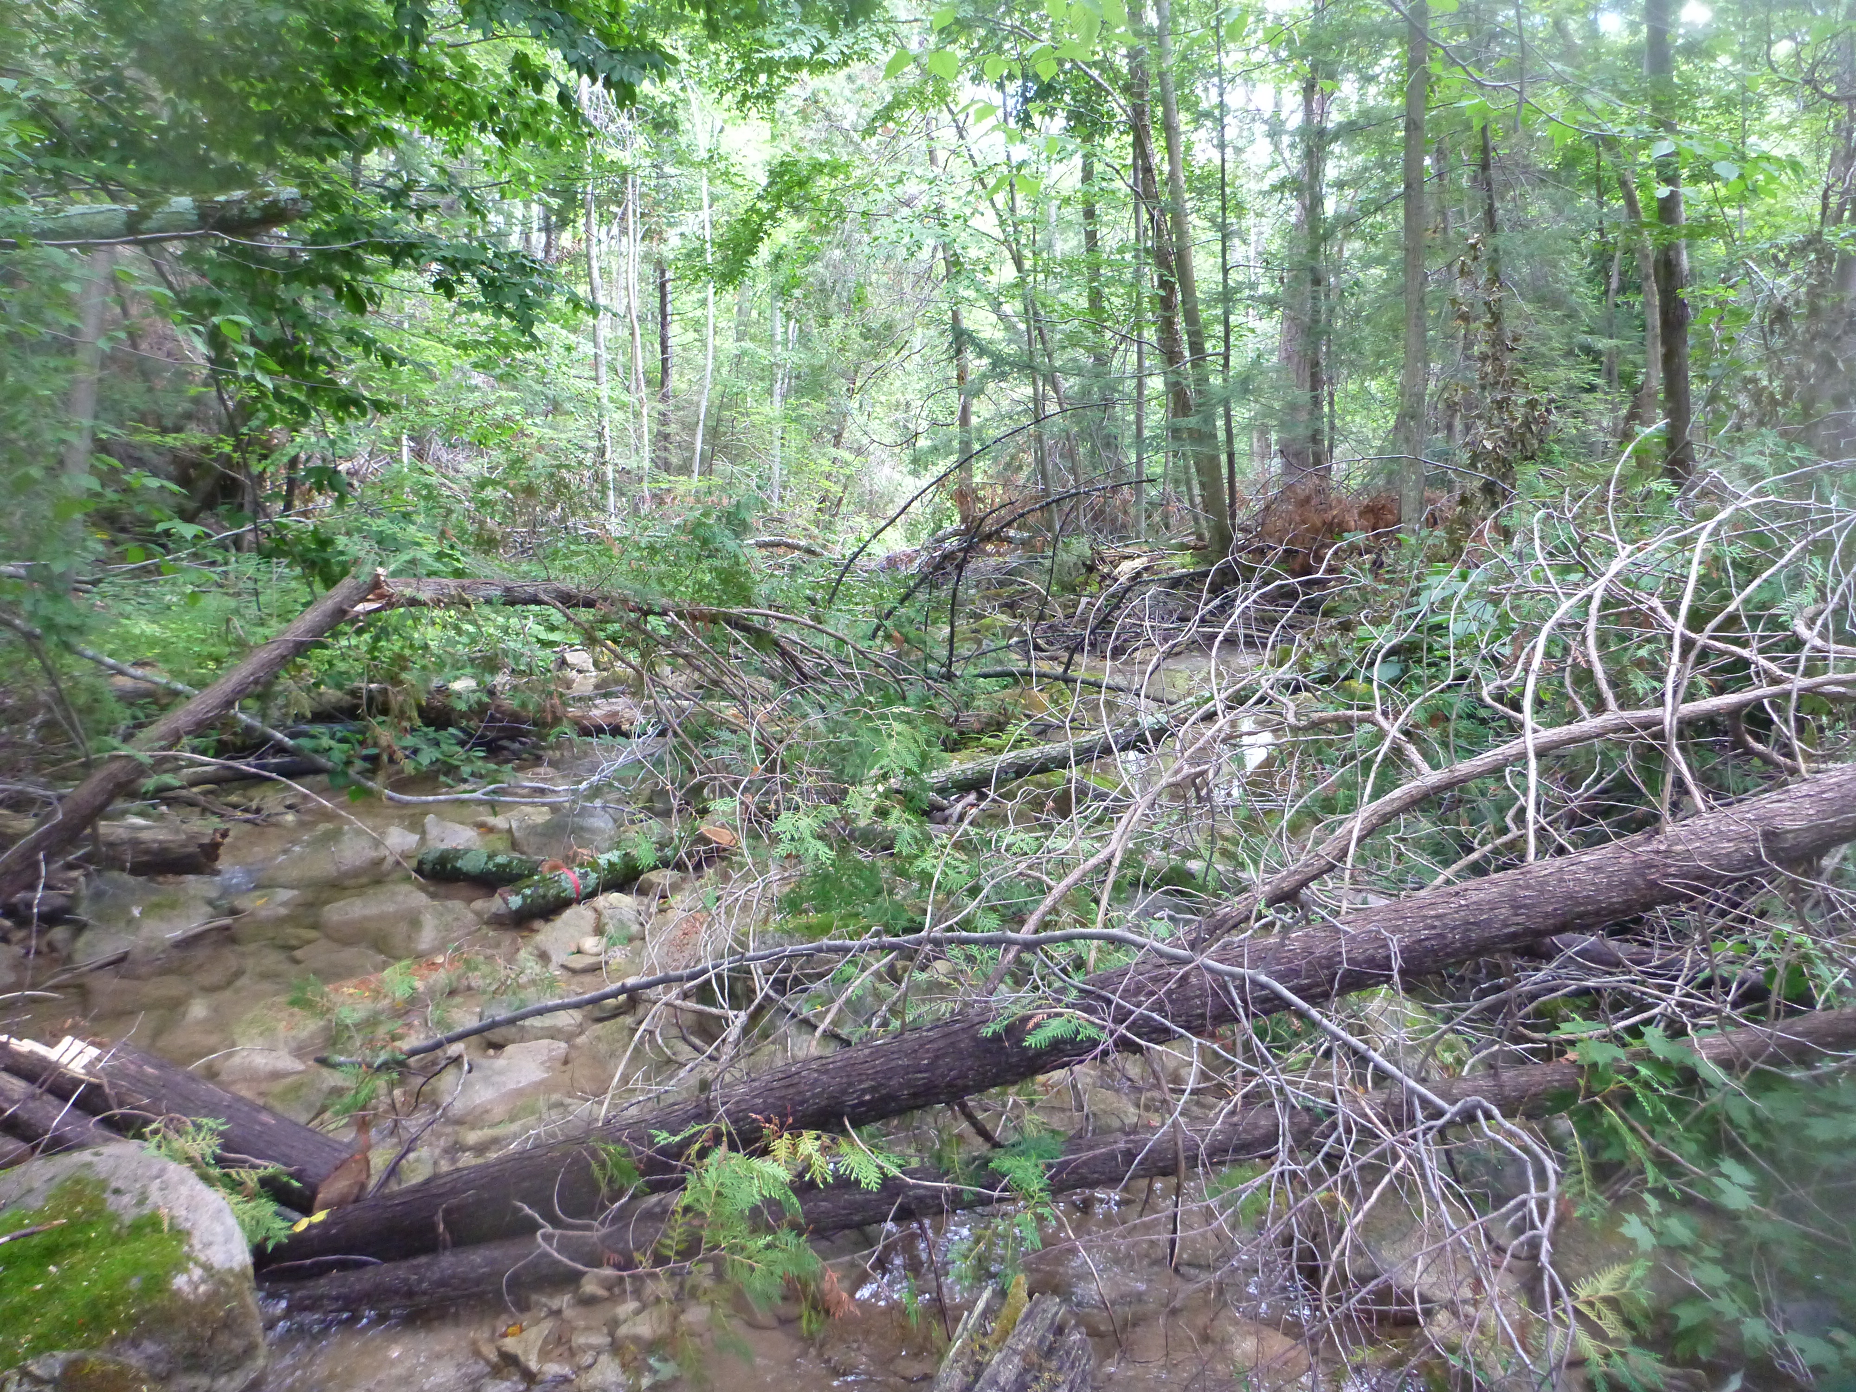
501110004 - Silver Creek

Slide 24
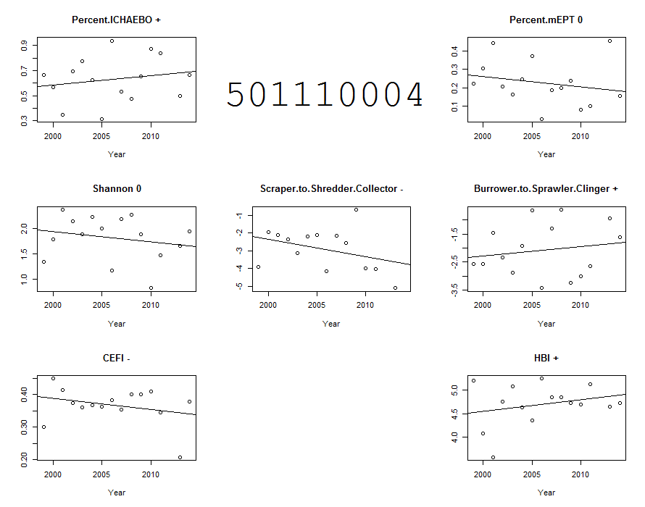

Slide 25
Results
2 models built for each metric
Site trend model:
metric ~ Sampling_Method + (Year | Site) + (1 | Year)
If 95% Confidence Intervals of the slope parameter “year” do not overlap 0, we consider the trend significant
Watershed and Zone trend model:
metric ~ Sampling_Method + Zone*Year + (Year | Site) + (1 | Year)

Slide 26
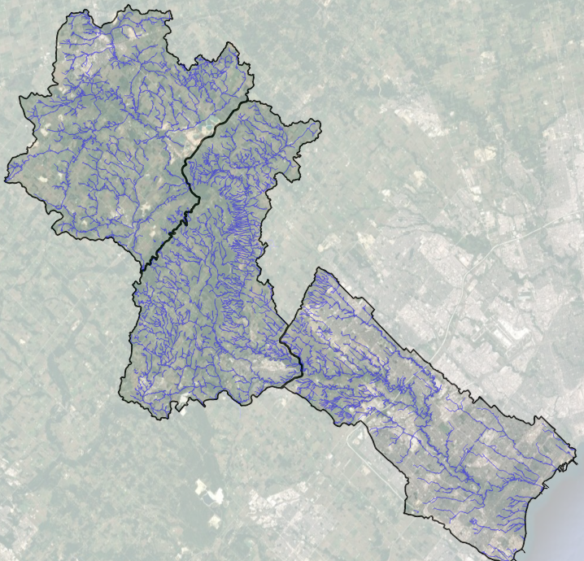
Results 2 – Watershed/Zone trend model
Build simple to complex models:
~ Sampling_Method + Zone*Year + (Year | Site) + (1 | Year)
~ Sampling_Method + Zone+Year + (Year | Site) + (1 | Year)
~ Sampling_Method + Year + (Year | Site) + (1 | Year)
~ Sampling_Method + Zone + (Year | Site) + (1 | Year)
~ Sampling_Method + (Year | Site) + (1 | Year)

Slide 27
Results 2 – Watershed/Zone trend model
Use Information Criterion approach to determine how much variation each model explains weighted by the degrees of freedom used
But there often isn't overwhelming evidence for one model over the rest
Therefore we average the parameter estimates of the best performing models.

Slide 28
Results 2 – Watershed/Zone trend model
Class | Metric | Response Variable | Number of Models | Global Slope | Global Intercept | Zone Intercept |  |  | Zone Slopes
 |  |  |  |  |  | L | M | U | L | M | U
Taxonomic/ Compositional | ICHAEBO | Percent | 2 |  |  | 90% | 56% | 68% | 0.70% | 0.70% | -3.00%
 | mEPT | Percent | 2 |  |  | 1.80% | 10% | 5.60% | -5% | 3% | 9%
 | Shannon | Gaussian | 2 | 0.001 |  | 1.39 | 1.89 | 1.91
Functional | Shrap:ShredCol | Gaussian | 2 |  |  | -2.25 | -1.33 | -2.02 | -0.002 | 0.008 | 0.08
 | Burr:ClingSprawl | Gaussian | 3 | -0.03 |  | 0.2 | -0.16 | -0.17
 | CEFI | Gaussian | 3 | 0.0003 |  | 0.25 | 0.24 | 0.23
Tolerance | HBI | Gaussian | 2 | -0.007 |  | 6.72 | 5.42 | 5.62

Slide 29
Notes:
Questions slide.

Slide 30
Notes:
End slide

Slide 31
Online Resources
http://www.ashander.info/posts/2015/04/D-RUG-mixed-effects-viz/
https://rpubs.com/bbolker/glmmchapter
http://www.ats.ucla.edu/stat/mult_pkg/glmm.htm
https://dynamicecology.wordpress.com/2015/11/04/is-it-a-fixed-or-random-effect/

Slide 32
Other References
Gelman, A., & Hill, J. (2006). Data analysis using regression and multilevel/hierarchical models.Cambridge University Press.
Kruschke, J. K. (2013). Posterior predictive checks can and should be Bayesian: Comment on Gelman and Shalizi,‘Philosophy and the practice of Bayesian statistics’. British Journal of Mathematical and Statistical Psychology, 66(1), 45-56.
Bates, D.M. (2010). lme4: Mixed-effects modeling with R. (Unpublished.)
Bolker, B.M., Brooks, M.E., Clark, C.J., Geange, S.W., Poulsen, J.R., Stevens, M.H.H., & White, J.S.S. (2009). Generalized linear mixed models: a practical guide for ecology and evolution. Trends in ecology & evolution, 24(3), 127-135.
Johnson, J. B., & Omland, K. S. (2004). Model selection in ecology and evolution. Trends in ecology & evolution, 19(2), 101-108.
Zhang, X., Zou, G., & Liang, H. (2014). Model averaging and weight choice in linear mixed-effects models. Biometrika, 101(1), 205-218.
Buckland, S.T., Burnham, K.P., & Augustin, N.H. (1997). Model selection: an integral part of inference.Biometrics, 603-618.

